Slide 1
TEAM ZILLION CODERZ
ADBMS PROJECT
BANK PROSPECT DATASET ANALYSIS USING AWS
PRESENTED TO
Professor.Tseng-Ching James Shen
PRESENTED BY
Manoj Mahinish Rajaboina SurrajKumar Prabhu

Slide 2
Table of Contents
Overview of Design
Overview of Implementation
Demo

Slide 3

Problem Statement
INTRODUCTION
  For banks trying to enhance client acquisition, segmentation, risk management, and competitive advantage, bank prospect data is a valuable tool. Effective use of this data can help banks boost client satisfaction and loyalty, spur economic expansion, and achieve long-term success.

Slide 4
DATASET
Since keeping bank prospect data confidential is important to protect the privacy and security of customers, comply with regulations, prevent fraud, maintain a competitive advantage, and build trust and confidence among customers, we have decided to leverage the use of ChatGPT to generate a dataset for this project.

Slide 5
Overview of the design
Version - 1
Selecting a Data Set
Generating a Bank Prospect Dataset from ChatGPT and Cleaning the dataset.
Uploading the dataset to s3 bucket
By using AWS CLI dataset from local machine is imported to AWS S3 bucket.
Data extraction, transformation and load
The data will be extracted, transferred and loaded (ETL ) using glue. Crawler is used to create metadata table to load data from s3 and it will store back data in glue data catalog and again glue data stores the data back in s3 in the format in which Athena can read the data.
Query the data
The data will be transformed using AWS Athena for queries. The Athena will access data through glue data catalog which is a central metadata repository.
5
Data visualization
Visualizing the data using AWS Quicksight.

Slide 6
Overview of the design
Version - 2
Generating a Data Set
Importing the dataset from local to S3 via AWS CLI
Creation and starting of EMR Cluster(Spark Code)
Model Prediction in AWS Sagemaker / Jupyter Notebook
Setup in AWS Athena
Creation of AWS Glue Crawler for ETL Processing
Data Visualization in Tableau
Deployment in Tableau Online
5

Slide 7
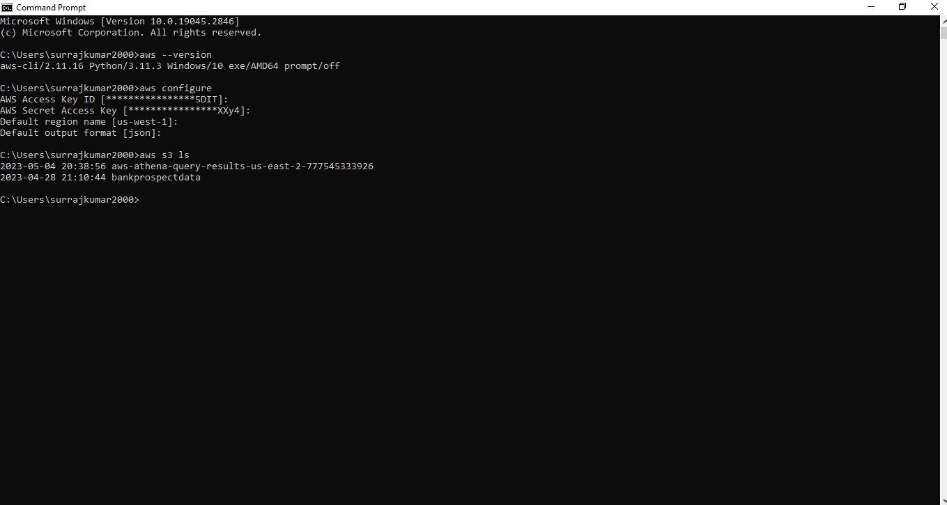
Test Results:
AWS CLI SETUP CONFIGURATION:
In our project we are using AWS CLI (Command Line Interface) to import the dataset from the local machine to AWS S3 bucket.
Since the main objective of our project is to make an end to end flow this setup will help in automating the process.

Slide 8
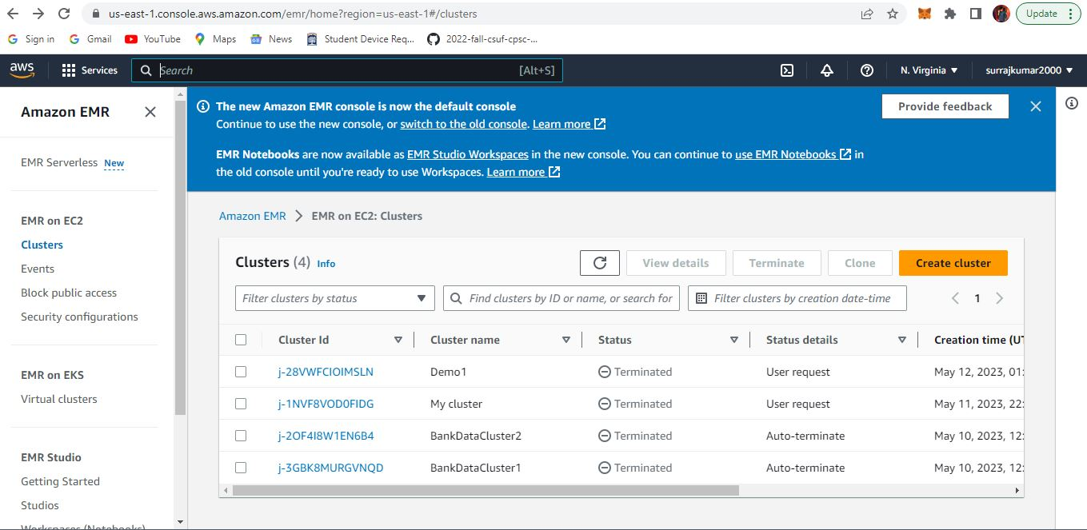
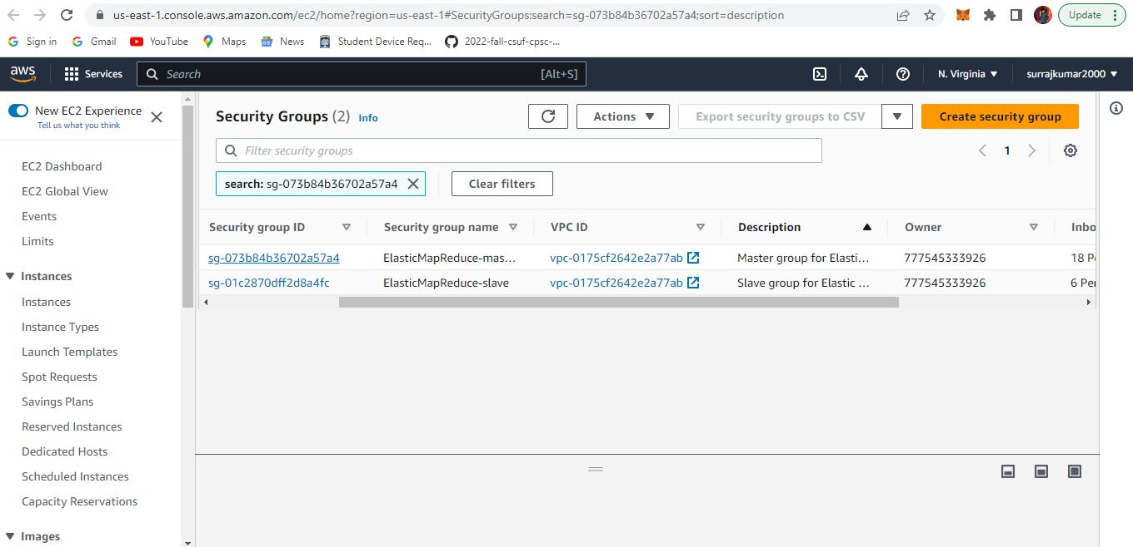
AWS EMR SETUP CONFIGURATION:

Slide 9
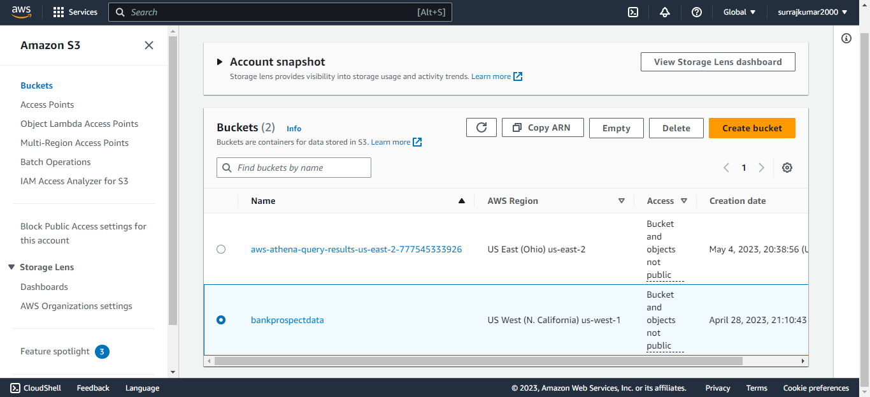
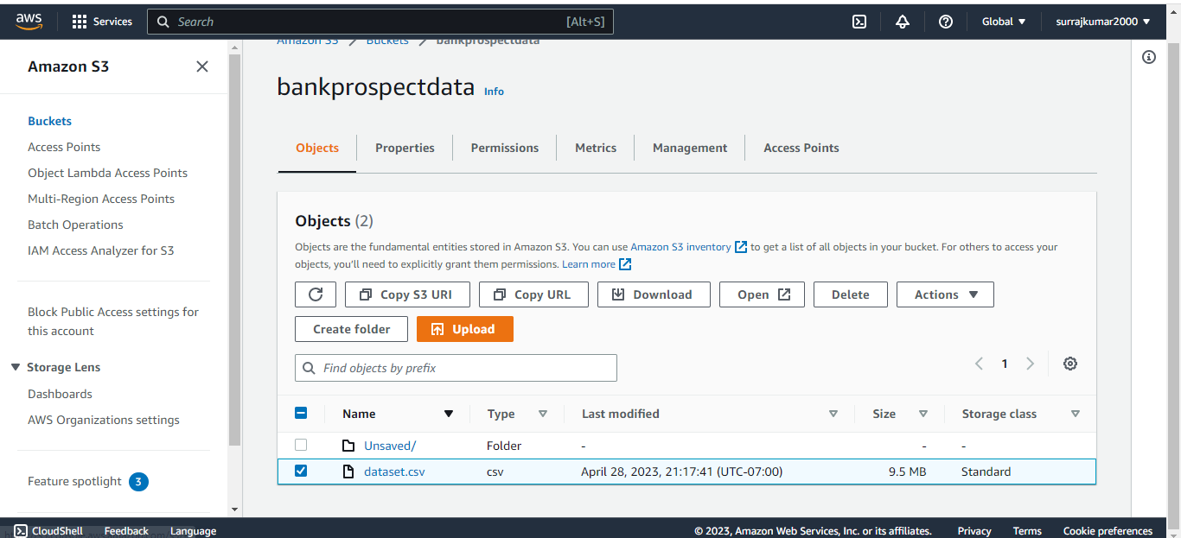
AWS S3 BUCKET:

Slide 10
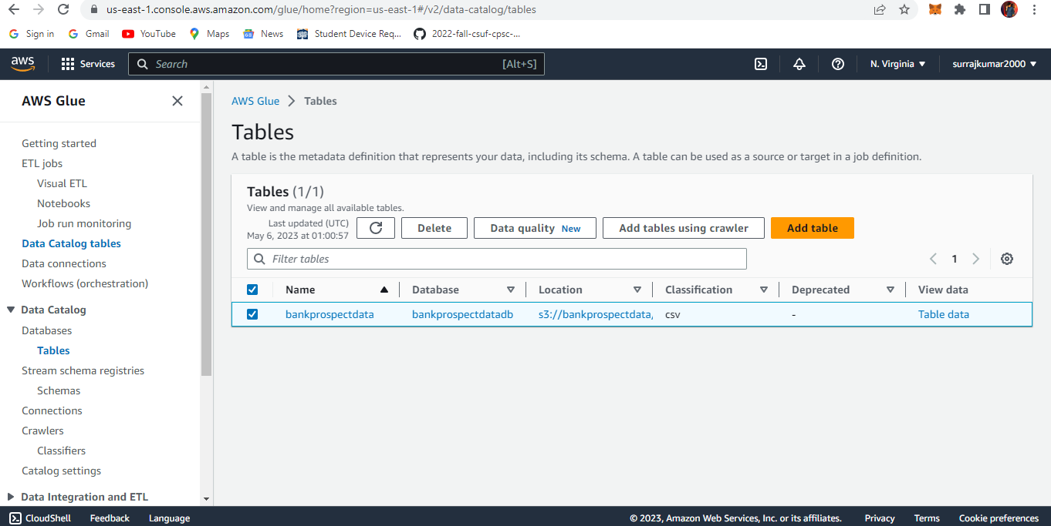
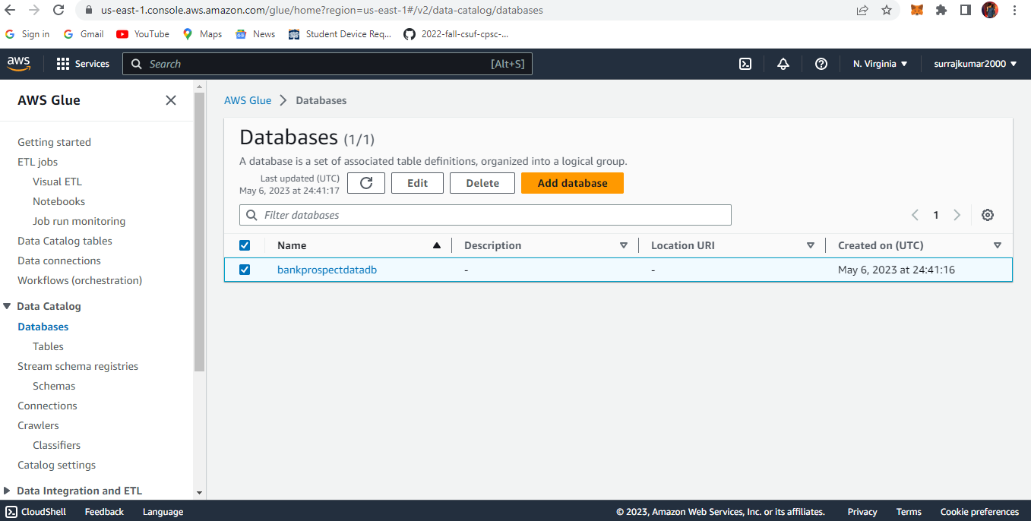
AWS GLUE SETUP CONFIGURATION:

Slide 11
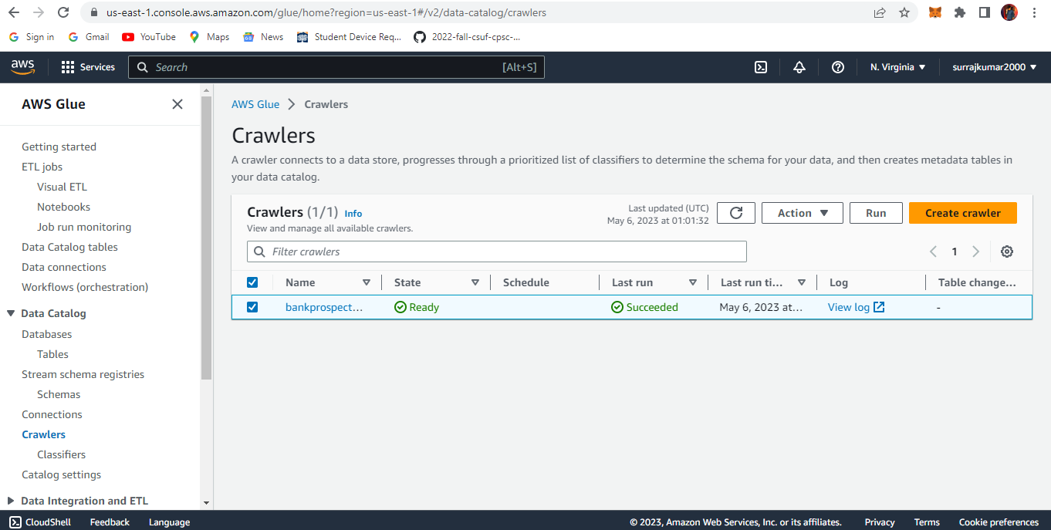
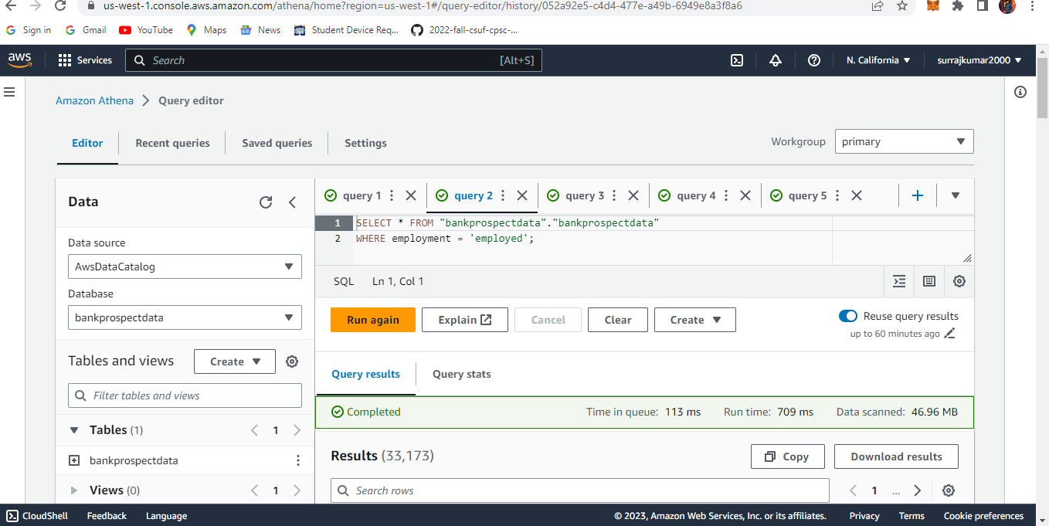

Slide 12
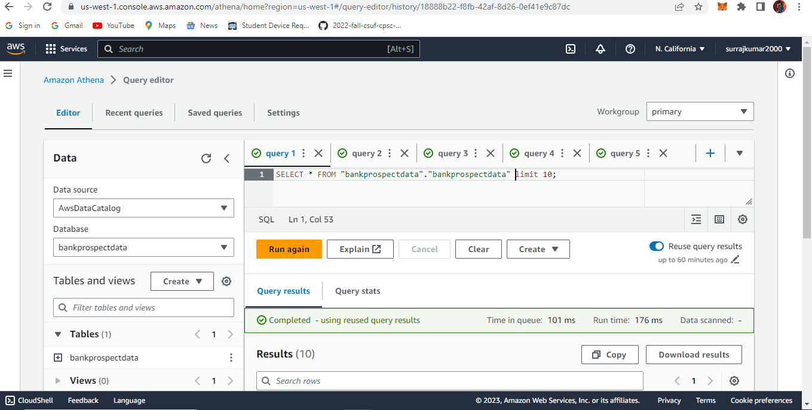
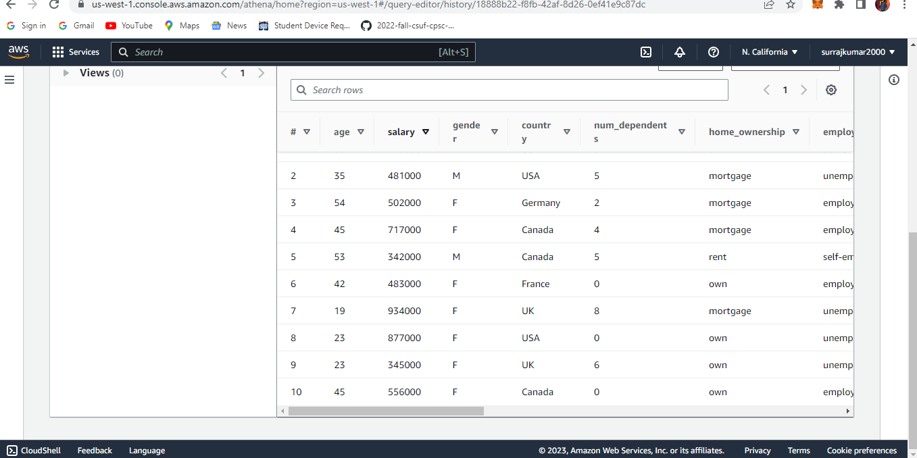
AWS ATHENA SETUP CONFIGURATION:

Slide 13
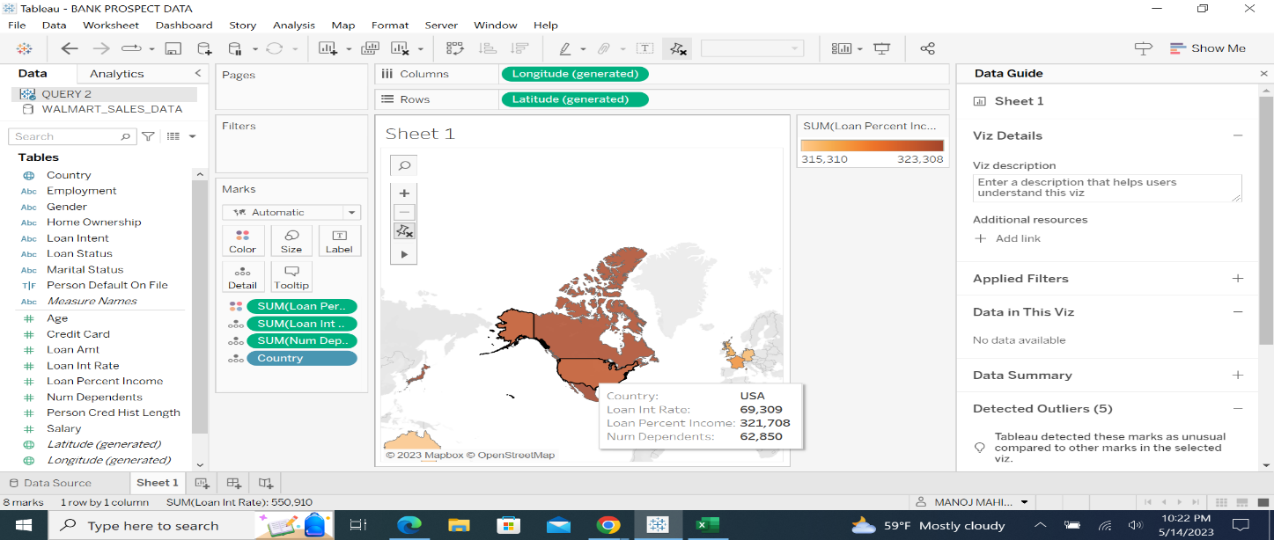
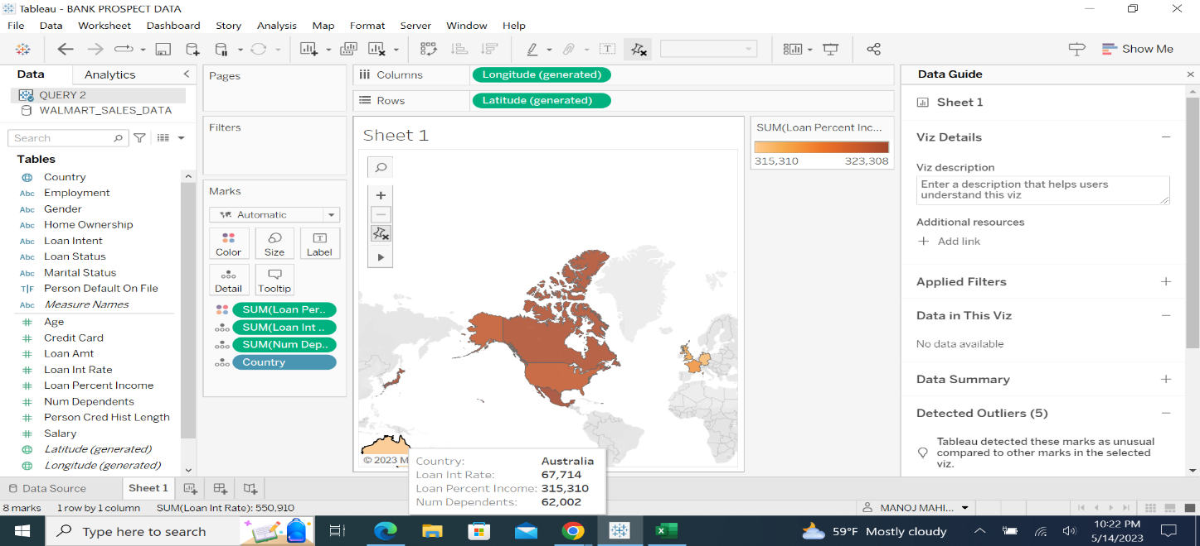
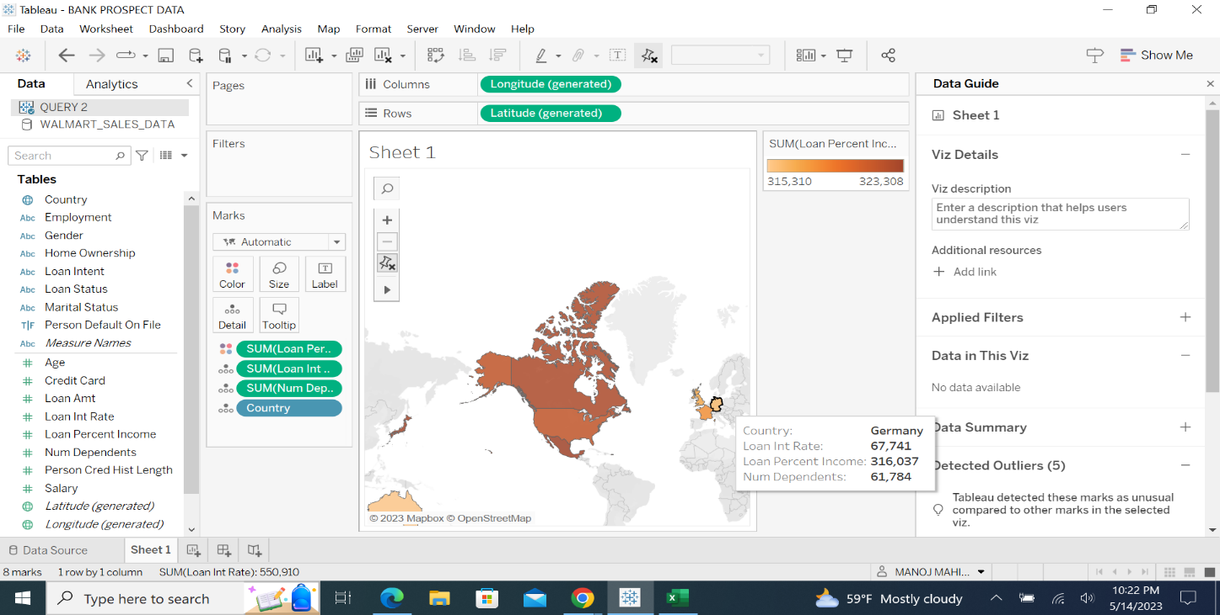
TABLEAU SETUP:

Slide 14
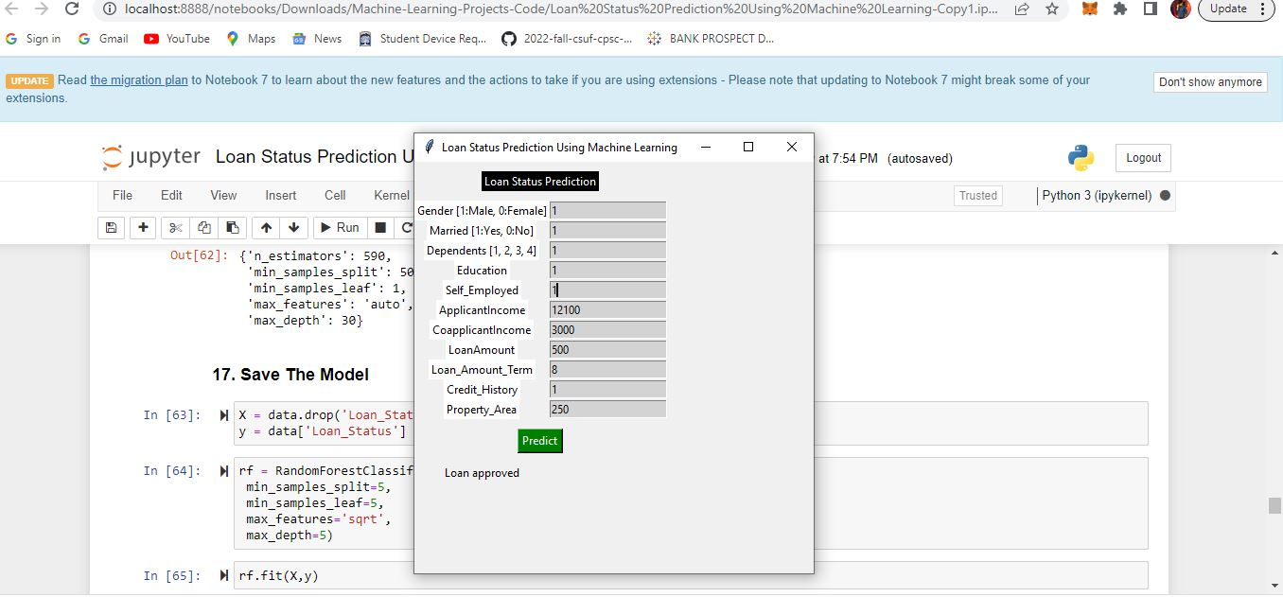
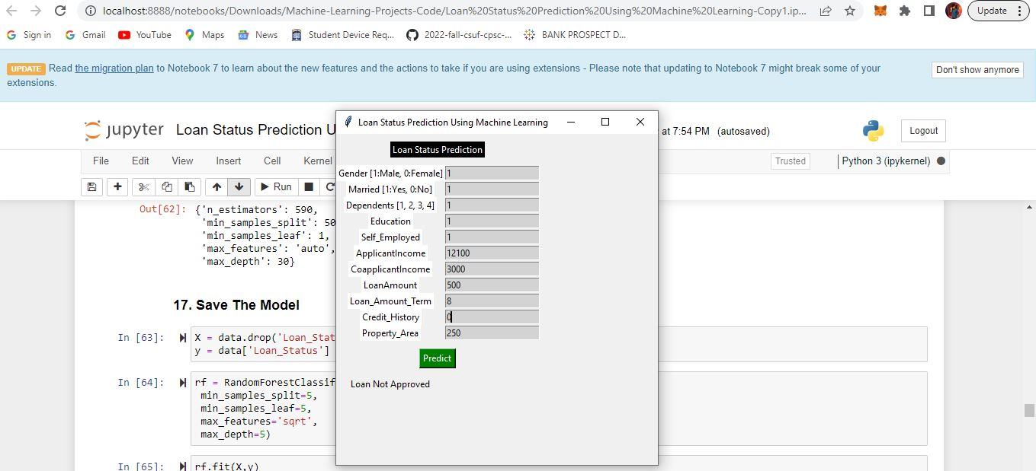
MODEL PREDICTION:

